Slide 1
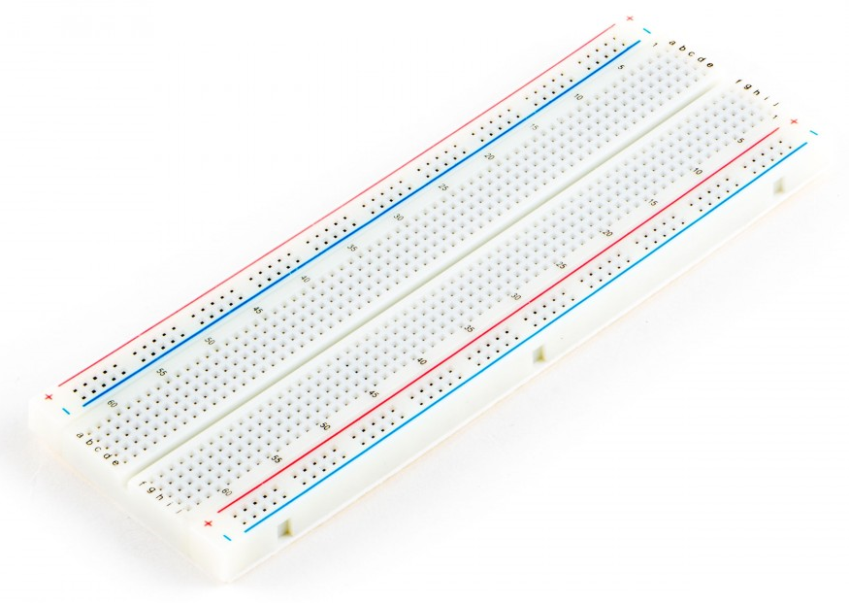
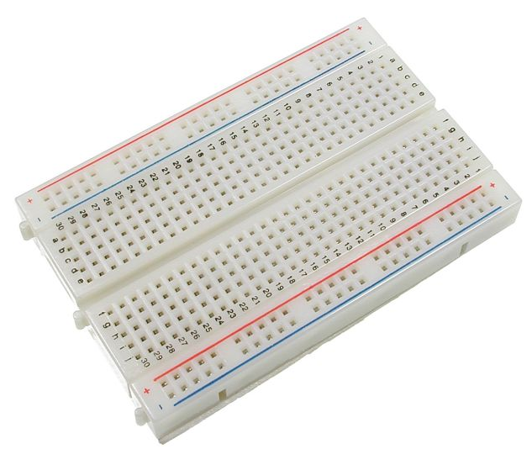
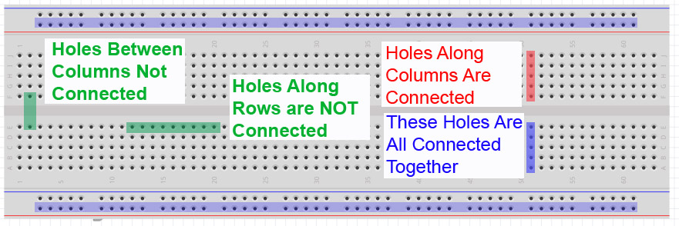
Hardware Basics
How breadboards are connected:
Power and Ground Rails: each ROW connected

Slide 2
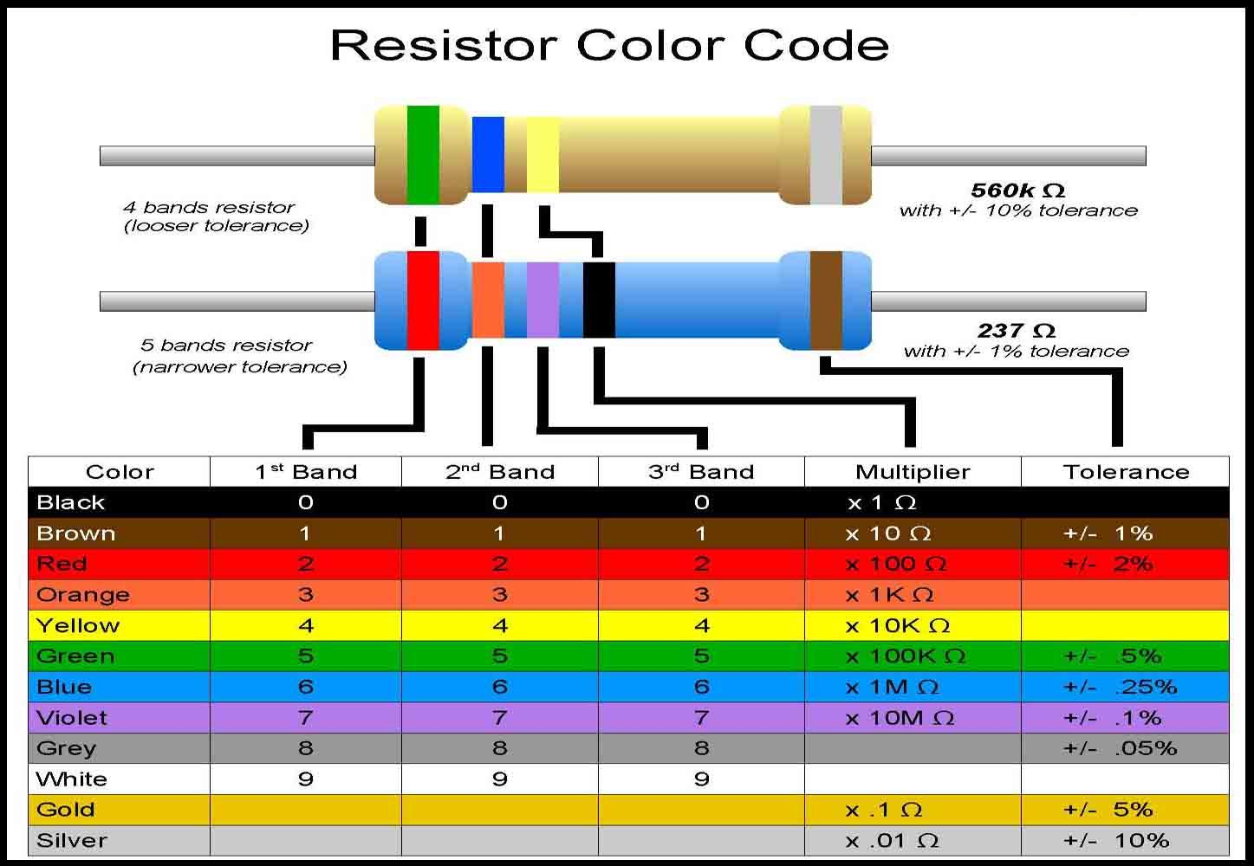
Hardware Basics
Image: http://nearbus.net/wiki/images/7/7d/Resistor_color_codes.jpg

Slide 3
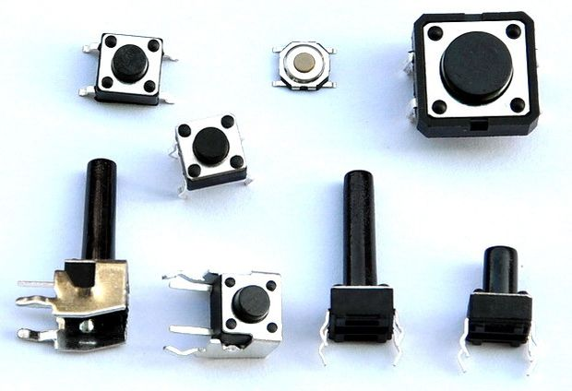
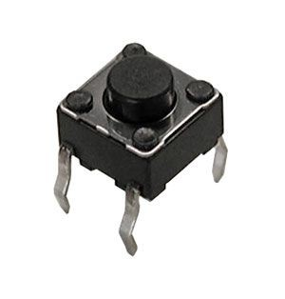
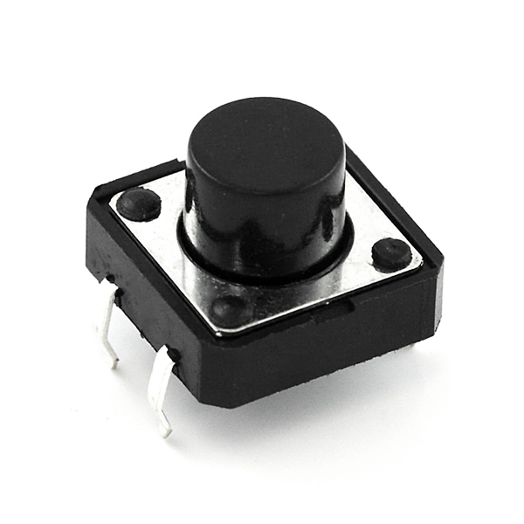
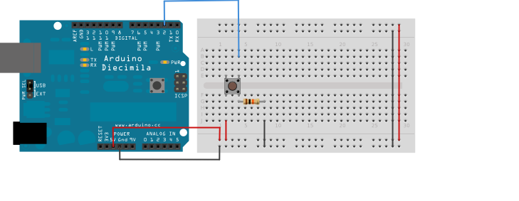
Buttons and LEDs
Arduino tutorial on buttons: https://www.arduino.cc/en/Tutorial/Button
NOT Pushed
Pushed
Details in example….

Slide 4
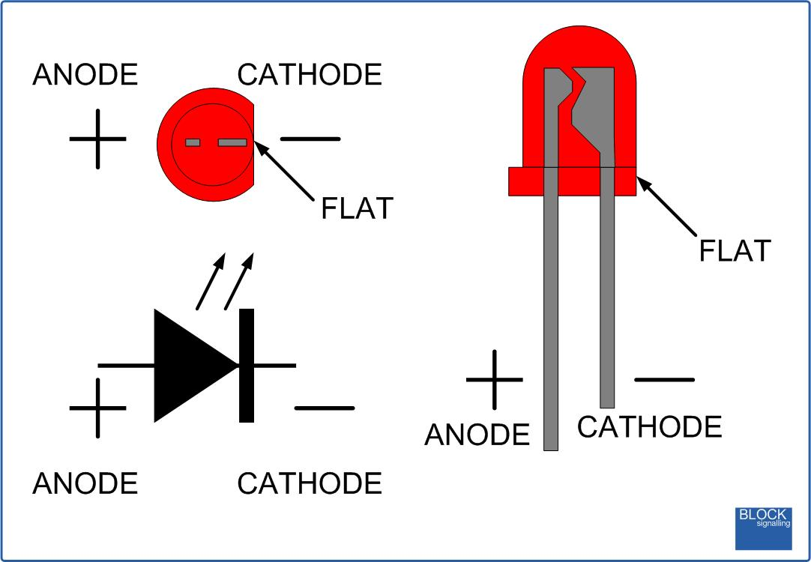
Buttons and LEDs
Which One’s The Negative?
Larger inside part
Shorter lead
Flat on casing
Why must I always use a resistor in series?
Limit the current (it will go flash, pop, and never light up again☹)
What Resistor Should I Use?
Varies based on color, size, and batch from manufacturer
Generally limit to well below 20 mA -> I wouldn’t go lower than 100 Ω
220 Ω is a generally good value

Slide 5
The serial Monitor
Serial port is used for communications to computer/other devices
Also known as UART (Universal Asynchronous Receive and Transmit)
Must match the baud rate in code to serial monitor (9600)
Baud rate = rate information transferred over the channel – 9600 bits per second
Arduino Leonardo is different to Uno when it comes to the USB connection
Uno has 2 separate processors, one for USB communication, one for your code
Leonardo just has one – more flexibility and cheaper, but serial port is virtual
Each time you press reset, the serial communication is broken and re-established
Any program that has an open serial connection to the Leonardo will lose its connection (in contrast to the Uno)
More info: https://www.arduino.cc/en/Guide/ArduinoLeonardoMicro

Slide 6
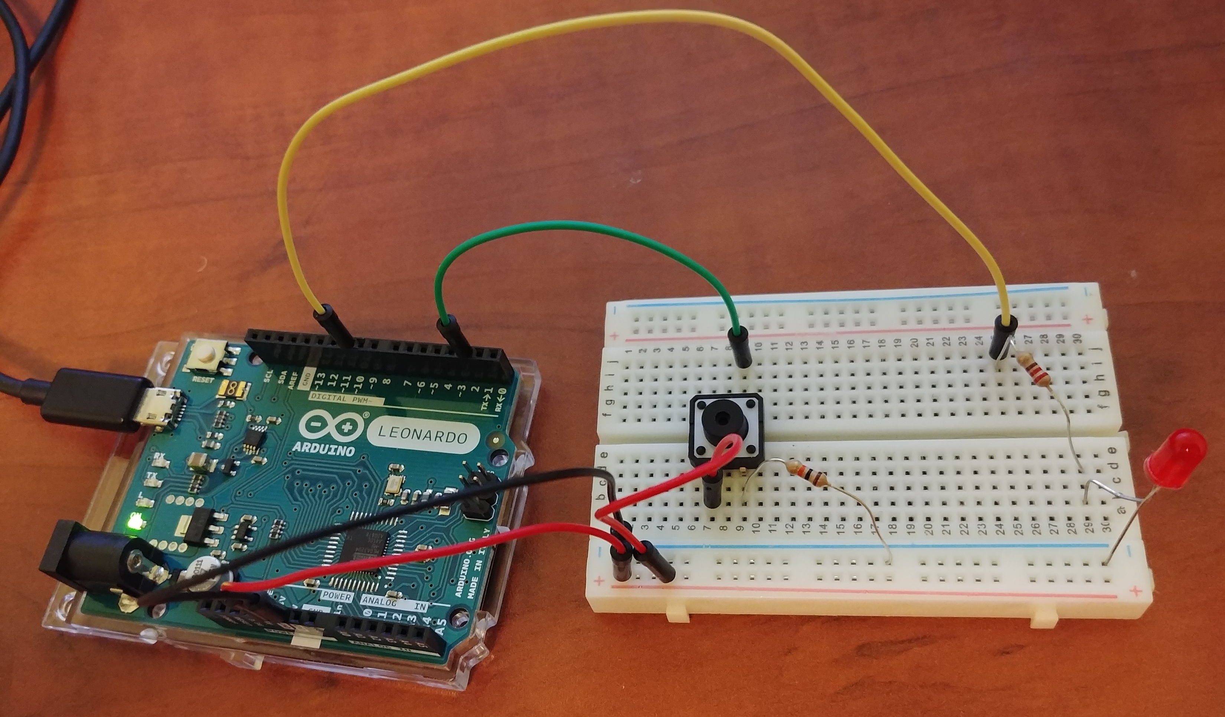

Slide 7
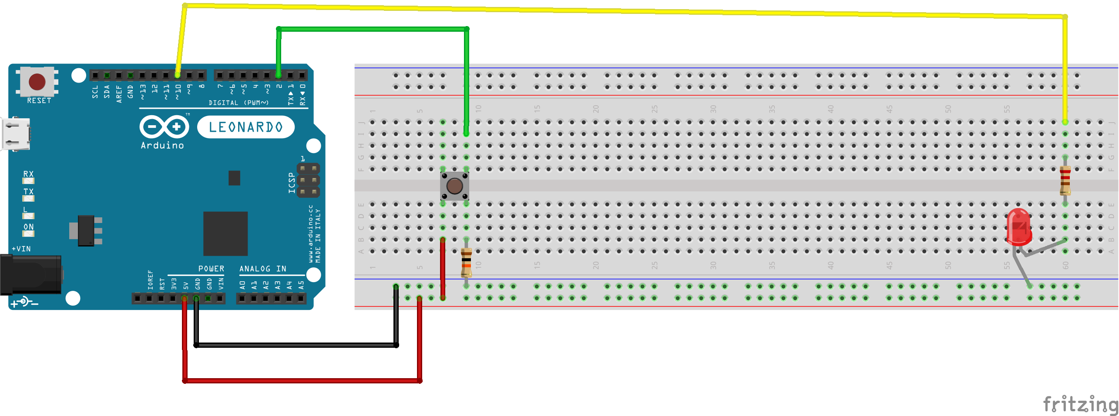
Example
Button Signal (Pin 2)
LED Output (Pin 10)
220 Ω
Ground (GND)
Large inside part goes to ground
Power (5V)
Pull-Down Resistor (10 KΩ)

Slide 8

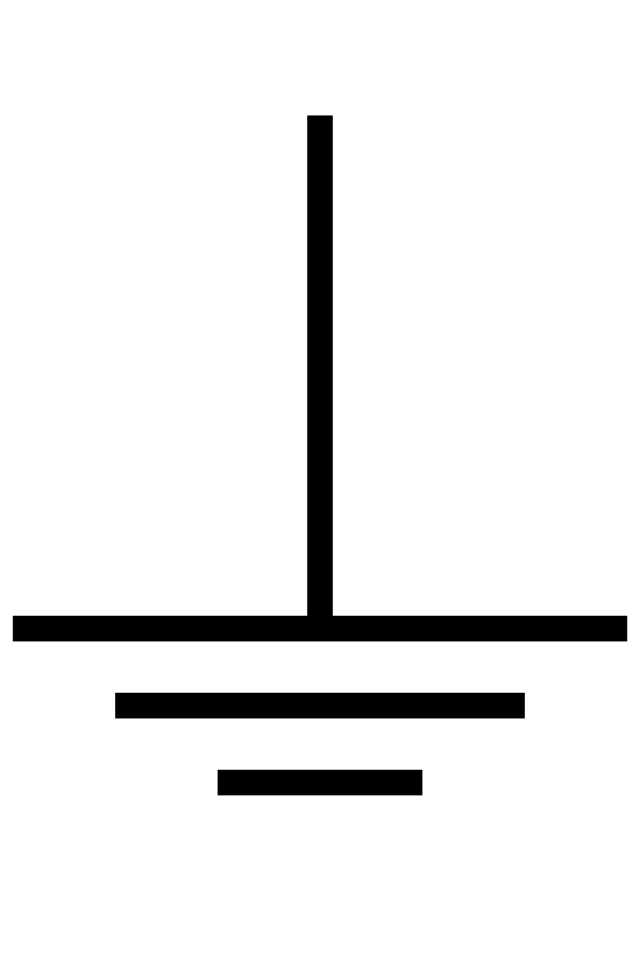
Why the Pull-Down Resistor?
Signal
Input to Arduino must be at an expected logic level (High or Low)
If nothing is connected, it’s not a logical zero (floating value)
When not pressed, signal is connected directly to ground (pulled down to 0V)
When pressed, there is a 5V drop across the resistor
At the top of the resistor, the potential its 5V
Ground (GND)
LOW
HIGH
Power (5V)
5V
0V
0V

Slide 9
Example
Go to https://github.com/
In the search bar, type in “Hackathin_Examples”

Slide 10
Example
Click on the repository
Click on “Button_LED_Serial”

Slide 12
state
Try commenting these out

